Slide 1
Face Detection
Di Zhuang
Shuo Yan

Slide 2
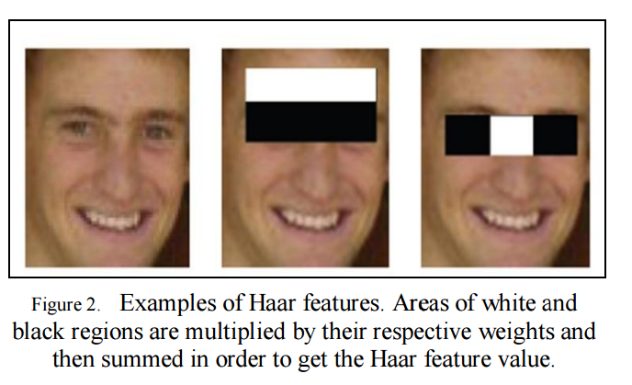
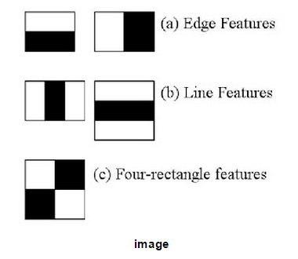
Haar features
Haar features are composed of either two or three rectangles. Face candidates are scanned and searched for Haar features of the current stage. The weights are constants generated by the learning algorithm. There are a variety of forms of features as seen below in

Slide 3
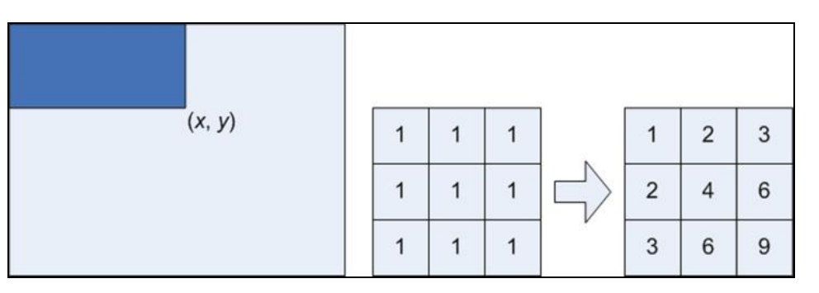
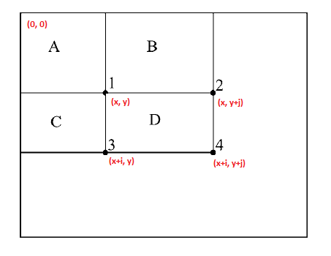
Integral image used to calculate the feature value

Slide 4
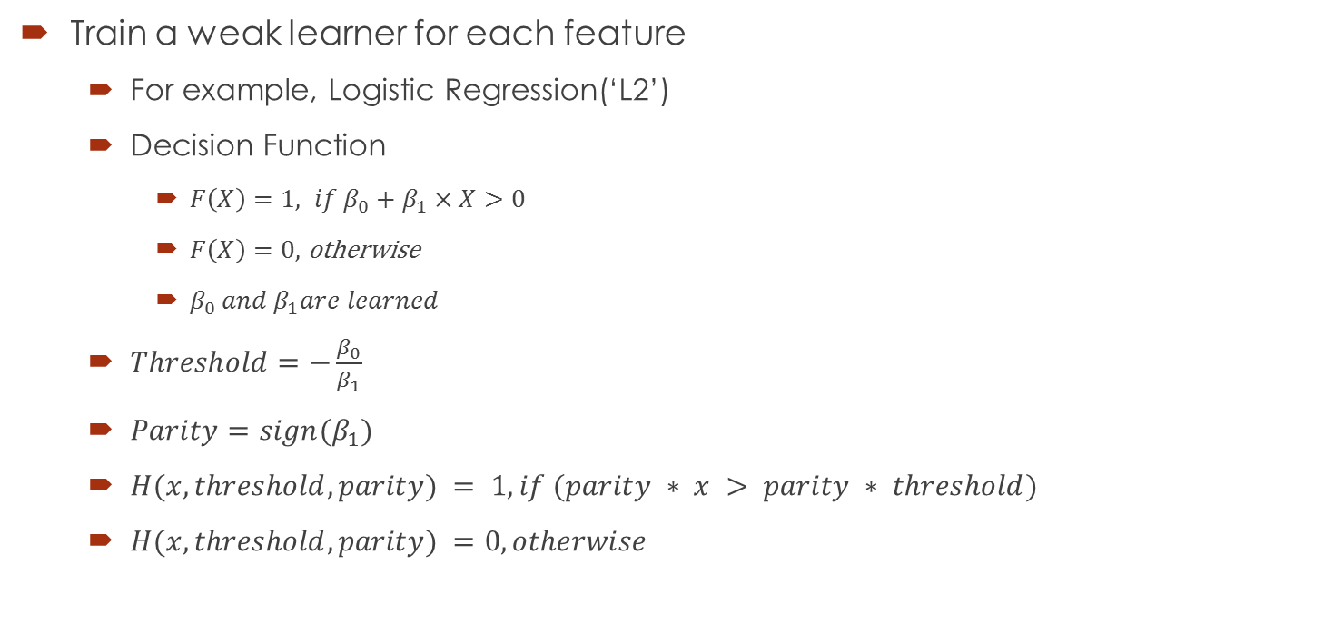
Viola Jones Algorithm (Step 1)
Train a weak learner for each feature
For example, Logistic Regression(‘L2’)
Decision Function
$F\left(X\right)=1, if β_{0}+β_{1}×X>0$
$F\left(X\right)=0,$ otherwise
$β_{0} and β_{1}are learned$
$Threshold=−\frac{β_{0}}{β_{1}}$
$Parity=sign(β_{1})$
$H(x, threshold, parity) = 1, if (parity ∗ x > parity ∗ threshold)$
$H(x, threshold, parity) =0, otherwise$

Slide 5
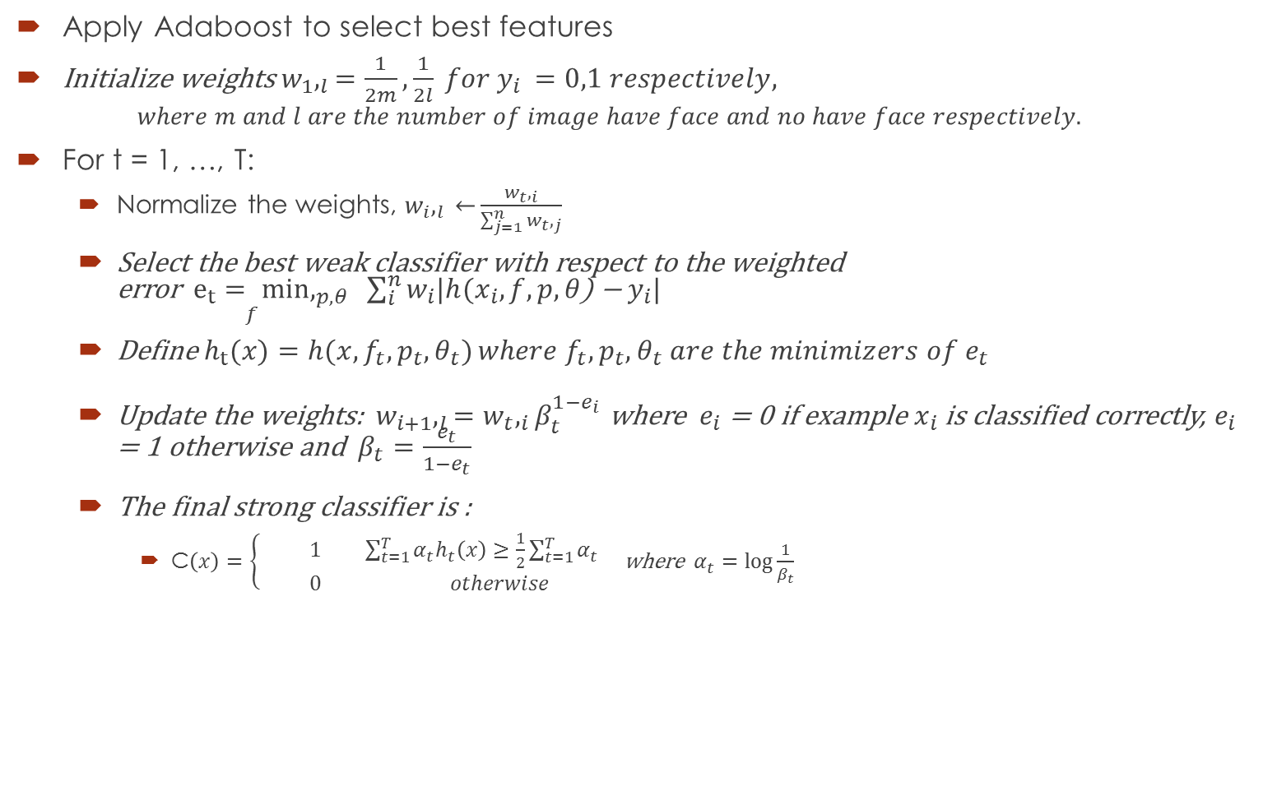
Viola Jones Algorithm (Step 2)
Apply Adaboost to select best features
Initialize weights $w_{1},_{l}=\frac{1}{2m},\frac{1}{2l} for y_{i }=0,1 respectively,$
$$where m and l are the number of image have face and no have face respectively.$$
For t = 1, …, T:
Normalize the weights, $w_{i},_{l} \overset{←}{}\frac{w_{t},_{i}}{\sum_{j=1}^{n}{w_{t},_{j}}}$
Select the best weak classifier with respect to the weighted error$\underset{f}{e_{t}= min}{,_{p, θ} }\sum_{i}^{n}{w_{i}|h(x_{i}, f, p, θ\text{)}\text{ − }y_{i}|}$
Define $\underset{}{h_{t}(x)=h(x, f_{t}, p_{t}, θ_{t})}{where f_{t}, p_{t}, θ_{t} are the minimizers of e_{t} }$
Update the weights:${ w}_{i+1},_{l}=w_{t},_{i}β_{t}^{1−e_{i}}$ where $e_{i}$ = 0 if example $x_{i}$ is classified correctly, $e_{i}$ = 1 otherwise and ${β_{t}=\frac{e_{t}}{1−e_{t}}}_{}$
The final strong classifier is :
C$\left(x\right)=\left\{\begin{aligned} 1 \sum_{t=1}^{T}{α_{t}h_{t}\left(x\right)≥\frac{1}{2}\sum_{t=1}^{T}{α_{t}}} \\ 0 otherwise\end{aligned}\right.$ where $α_{t}=\log{\frac{1}{β_{t}}}$

Slide 6
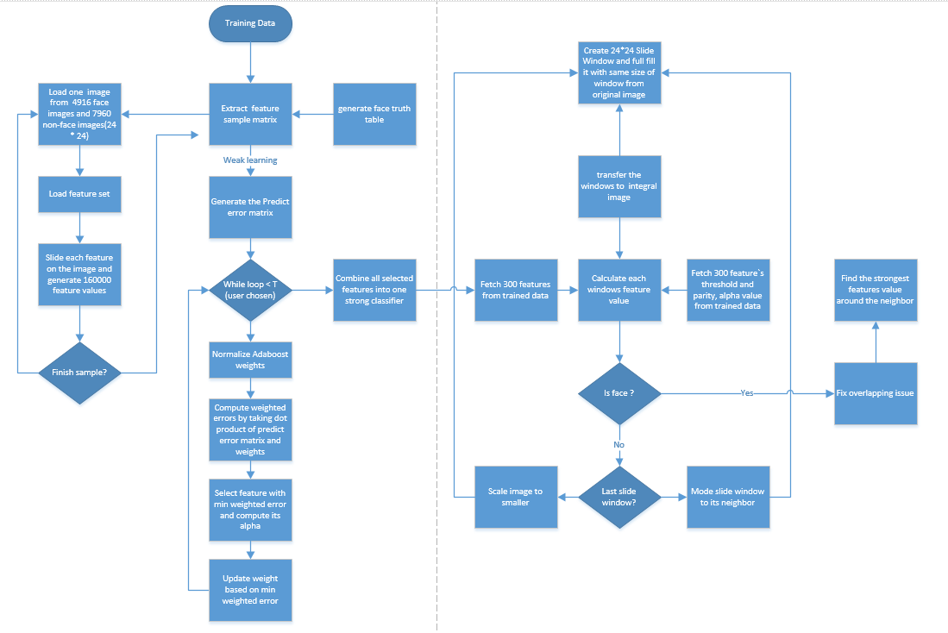
Implication Work Flow

Slide 7
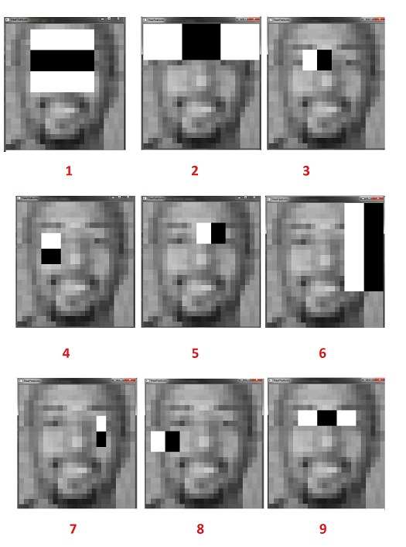
Training Results
Accuracy = 81.54%
FP rate = 22.00%

Slide 8
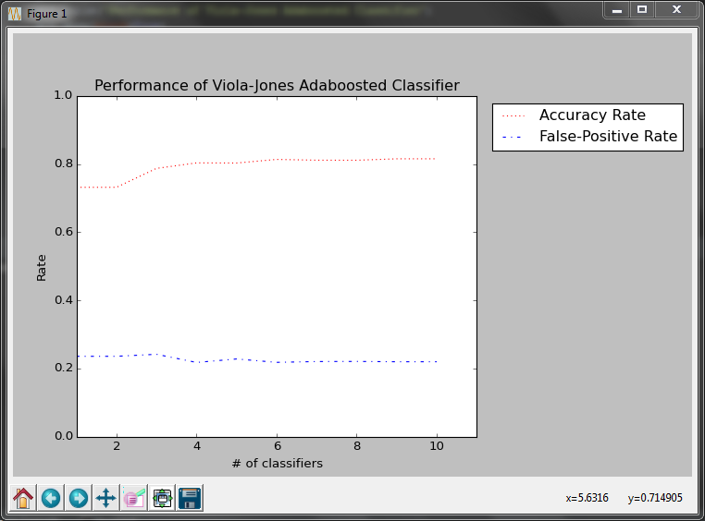
Final classifer performance

Slide 9
reference
[1] Paul Viola and Michael J. Jones. "Rapid object detection using a boosted cascade of simple features," in Computer Vision and Pattern Recognition, 2001. CVPR 2001. Proceedings of the 2001 IEEE Computer Society Conference on , vol.1, no., pp.I-511-I-518 vol.1, 2001
[2] Paul Viola and Michael J. Jones. 2004. Robust Real-Time Face Detection. Int. J. Comput. Vision 57, 2 (May 2004), 137-154.
[3] M.Gopi Krishna, A. Srinivasulu . Face Detection System On AdaBoost Algorithm Using Haar Classifiers

